Slide 1
Welcome to Back to School Night
Conceptual Chemistry
Mrs. Bilotta
Mr. Paturzo

Slide 2
Chemistry
Mrs. Bilotta

Slide 3
About Me
Mrs. Bilotta
I have been teaching science for over 20 years.
I am married and have 4 children, all boys.
My hobbies include crafts, halloween costumes, fishing and camping.

Slide 4
About Me
Mr. Paturzo
I have been teaching for over 20 years.
I am married and have 4 children, 2 boys and 2 girls.
My hobbies include baseball and golf.

Slide 5
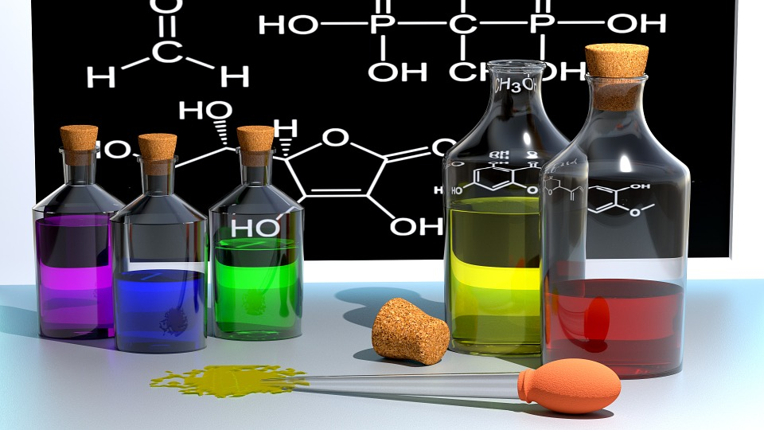
Course Outline
Matter Elements Compounds Naming Compounds Chemical Composition Chemical Reactions Chemical Bonding

Slide 6
Instruction Includes:
Powerpoint presentations
Demonstrations
Labs
Discussions
Practice
Cooperative
learning activities

Slide 7
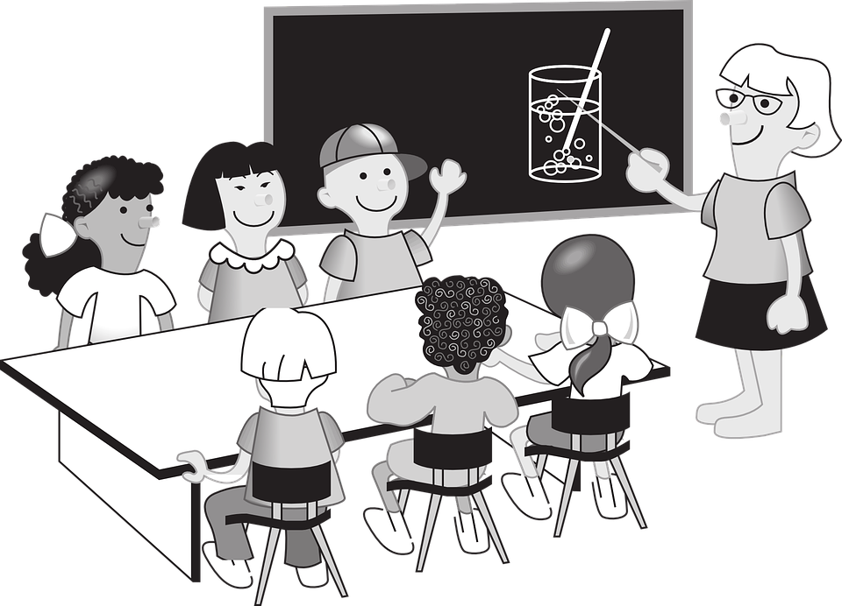
Classroom Policies

Slide 8
Homework
Homework is due on time
Late work will not be accepted
Homework assignments can be found on your child’s google classroom account
https://classroom.google.com/u/0/h

Slide 9
Classroom Rules
Follow all directions the first time
Enter class quietly on time and
prepared to work
Only one person talking at a time in any group setting
Stay in your seat unless you have
permission to get up
No eating, drinking, or gum chewing
Masks must be worn at all times

Slide 10
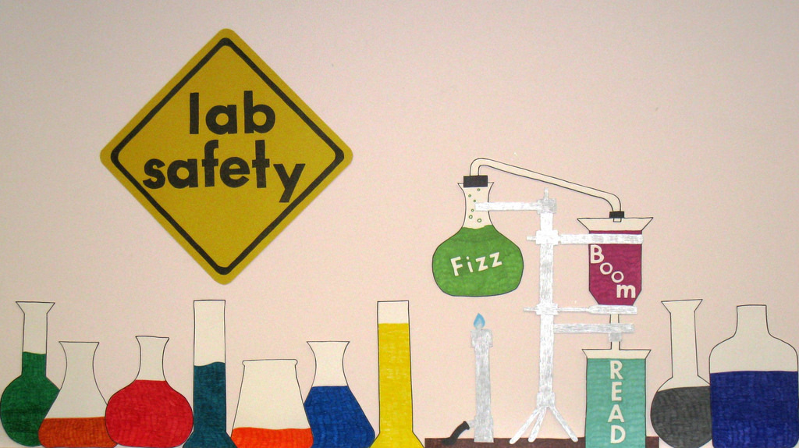
LAB SAFETY

Slide 11
Our Textbook
Website:
www.cengage.com
Each student has their own user name
and password

Slide 12
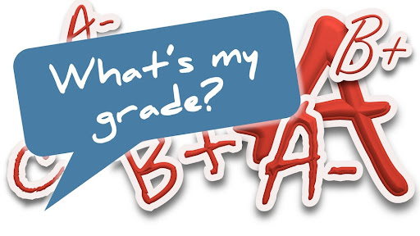
Grading Percentages
55% Assessment :
Tests
Quizzes
20% Homework:
Homework Assignments
Completing Lab Write-ups
25% Participation:
Class Participation
Lab Participation

Slide 13
Grades
Grades are available on genesis usually within days of completing work.

Slide 14
Help
Students should reach out whenever they need help.

Slide 15
How to Contact Me?
Email:
kmbilotta@jacksonsd.org
Phone :
(732) 833-4600
Call the school and leave a message
Either way, I will get back to you as soon as possible.

Slide 16
My School Wires class page
http://www.jacksonsd.org/Domain/601

Slide 17
??????? Questions ???????

